Slide 1
CentraXX FHIR
Mike Wähnert
2024-11-12

Slide 2
Introduction
Mike Wähnert
Kairos developer since 2013
Team lead for CentraXX dev group “interfaces & data science”
Tech lead for all Kairos developer
FHIR experience since 2019 (STU3)
Jonas Küttner
Kairos developer since 2021
Tobias Sieckmann
Project management since 2024
Helpdesk
https://helpdesk.centraxx.de

Slide 3
What is your practical FHIR experience?
Level 1: Worked with XML/JSON REST APIs before.
Level 2: Worked with one concrete FHIR API before.
Level 5: Implementer of a FHIR store, API
Level 6: I know FHIR CQL!
Level 0: No API experience.
Level 4 Designed new profiles, structure definitions or implementation guides before.
Level 3: Worked with multiple FHIR APIs and profiling before.
Level 6: I am member of the FHIR technical board in my country
Level 7: Call me for the dev team!

Slide 4
What is FHIR?
FHIR = Fast Healthcare Interoperability Resources
Data exchange standard between health care software systems
Introduces as the next level after HL7 v.2, v.3 and CDA
Supports web-based technologies like JSON, HTTP, TLS and OAUTH2, etc.
Supports RESTful architectures
Implementation and adaptation as needed
Supports existing terminologies like SNOMED, LOINC, UCUM, ICD10, etc.
Supports application specific terminologies e.g., CentraXX user defined catalogs

Slide 5
FHIR History
Specified by HL7 group
First proposal in 2011
DSTU 1 (official version) in 2014
DSTU 2 (official version) in 2015
STU 3 (FHIR Release 3) in 2019
R4 (FHIR Release 4) in 2019
R5 (FHIR Release 5) in 2023
R6 (Ballot 2nd draft) since 2024-08-13

Slide 6
FHIR is flexible.
FHIR allows
Partly implementations, e.g., only patient updates, no sample creates, etc.
Extending and restricting the API
Extending and restricting resources
Changing cardinalities
Primitive and complex data types
FHIR is self describing
Implemented resources and methods by capability statement
Extensions and restrictions by StructureDefinitions of each resource

Slide 7
Flexibility comes with complexity
Each FHIR API is different
FHIR specification on multiple levels
Base profiles: e.g., https://www.hl7.org/fhir/
Country specific, e.g., https://www.hl7.org/fhir/us/core/
Project specific profiles, e.g., https://simplifier.net/bbmri.de
Application specific profiles: e.g., https://simplifier.net/CentraXX-Structures
Important FHIR registries:
https://simplifier.net/
https://registry.fhir.org/
http://www.fhir.org/guides/registry/

Slide 8
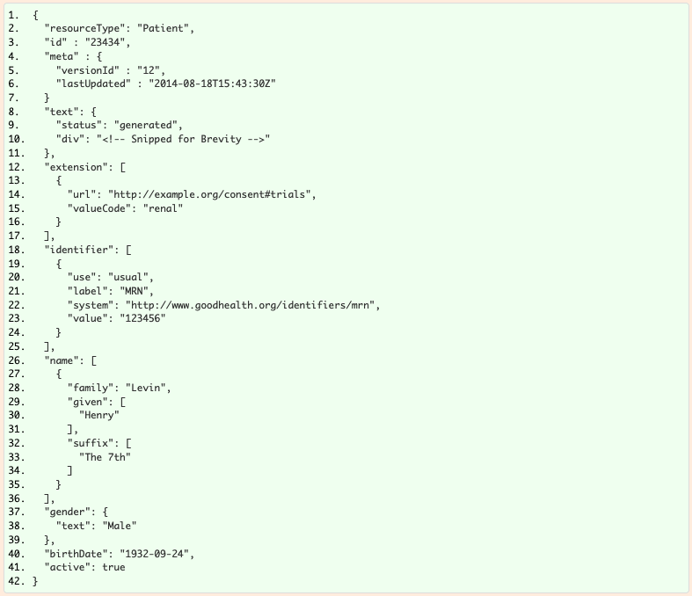
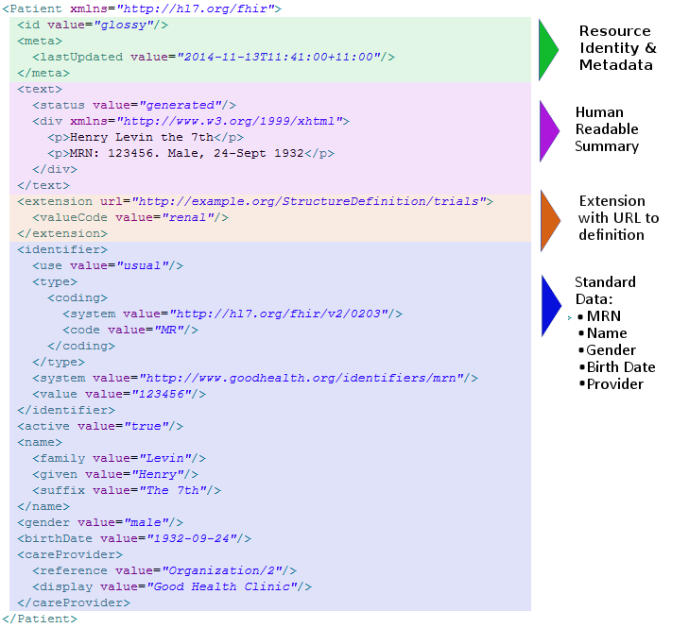
FHIR basics
Resource: Set of common data points for an entity, e.g., Patient, Specimen, etc.

Slide 9
FHIR basics
General specification (current version): https://hl7.org/fhir/
General specification (R4): https://hl7.org/fhir/R4/
Developer overview: https://www.hl7.org/fhir/overview-dev.html

Slide 10
CentraXX FHIR Interfaces
FHIR API
Capability statement: /centraxx/fhir/r4/metadata
CentraXX Profiling: https://simplifier.net/CentraXX-Structures
FHIR Custom Import/Export
Integrated ETL export processing for various profiling’s
Multiple import/export projects supported
Example project: https://github.com/kairos-fhir/kairos-fhir-dsl-mapping-example
FHIR Repository Connect
Integrated ETL loader for an external FHIR store
Single datapoint imports with staging dialog

Slide 11
Use cases
Kairos mobile apps connected by FHIR API
CentraXX as an ETL source system
CentraXX as an ETL target system
CentraXX as an ETL integration system for data harmonizing
Pulling datapoints from external FHIR store
Synchronizing data between multiple CentraXX systems
Federated searches with multiple CentraXX systems

Slide 12
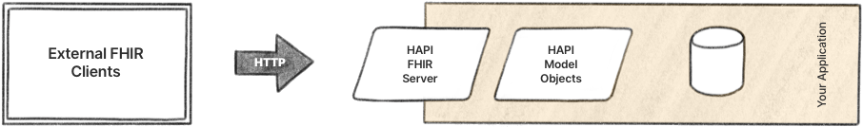
CentraXX FHIR API by HAPI
HAPI offers different integration models. Our model is:
Your Application: this is your CentraXX instance
R4 supported
Source: https://hapifhir.io/

Slide 13
CXX FHIR API: Security
Authentication
with CentraXX user
by HTTP Auth Basic (user + password)
by HTTP Auth Bearer (OAuth2/OIDC JSON Web Token)
Authorization
with CentraXX user rights
Full access
Patient based access
With/without pseudonymization

Slide 14
CXX FHIR API: supported resources (overview)
Patient
Specimen (Sample)
Condition (Diagnosis)
Encounter (Episodes)
Organization
Observation (Measurement findings)
Questionnaire (CRF Templates of CTMS)
QuestionnaireResponse (CRFs of CTMS)
Person (User/Participants)
Procedure (MedProcedures)
ResearchStudy (Study)
ResearchSubject (StudyMember /PatientStudy / Recruit Result)
Communication (HotlineProtocol)
CodeSystem (ICD10, Ops, User defined Catalogs, ValueLists)
ValueSet (Measurement parameter with controlled vocabulary)
Appointments (Calendar Events)
Consent
Flag (Universal attribute)
ServiceRequest
Task (User Tasks)
Binary (Binary Files)
Bundle
Location
List (Sample sets)

Slide 15
CXX FHIR API: methods
Single resources
Read (GET), create (POST), update (PUT), delete (DELETE)
No patch => use extension https://fhir.centraxx.de/extension/updateWithOverwrite
Multiple resources
Transaction bundles (POST)
Batch bundles (POST)
Named query searches (GET)
Bulk data export

Slide 16
CXX FHIR API: base URLs
Bundle Imports
Pattern: {http-schema}://{cxx-domain(:port)}/{fhir/r4}
Example: https://cxx4.kairosbochum.de/centraxx/fhir/r4
Single Resource (Create):
Pattern: {http-schema}://{cxx-domain(:port)}/{fhir/r4}/{resource-type}
Example: https://cxx4.kairosbochum.de/centraxx/fhir/r4/Patient
Put/Delete/GetById
Pattern: {Single resource URL}/{logical-fhir-id}
Example: https://cxx4.kairosbochum.de/centraxx/fhir/r4/Patient/11
Named Queries
Pattern: {Single resource URL}/?_query={queryName}&{parameterName1}={parameterValue1} &{parameterName2}={parameterValue2}&…
Example: https://cxx4.kairosbochum.de/centraxx/fhir/r4/Patient?_query=searchByDecisiveId&idType=MPI&psn=2023-06-26
More Details in the FHIR-Spec: https://www.hl7.org/fhir/http.html

Slide 17
Queries by FHIR Search
https://www.hl7.org/fhir/search.html#advanced
Many request by FHIR named queries
E.g.: centraxx/fhir/r4/Observation?_query=searchBySubject&subject=Patient/4711&locale=en
All queries (as operations) and parameters listed in the Capability Statement
Further request implementations possible (by feature request)

Slide 18
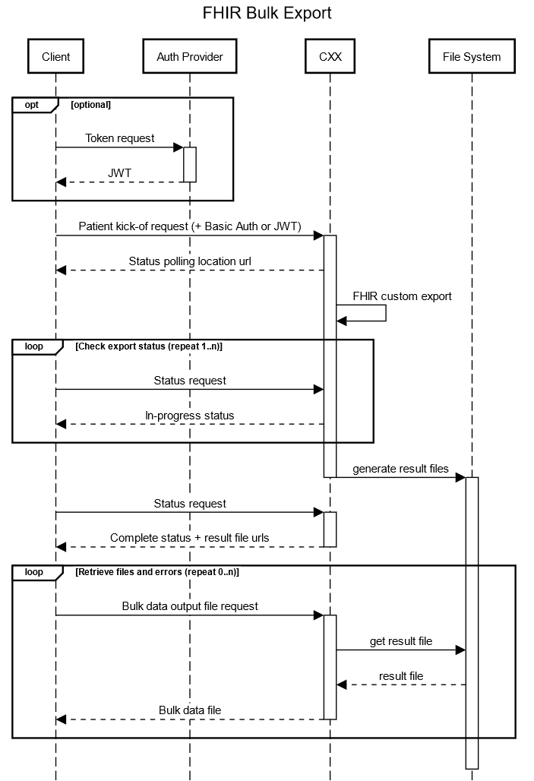

Slide 19
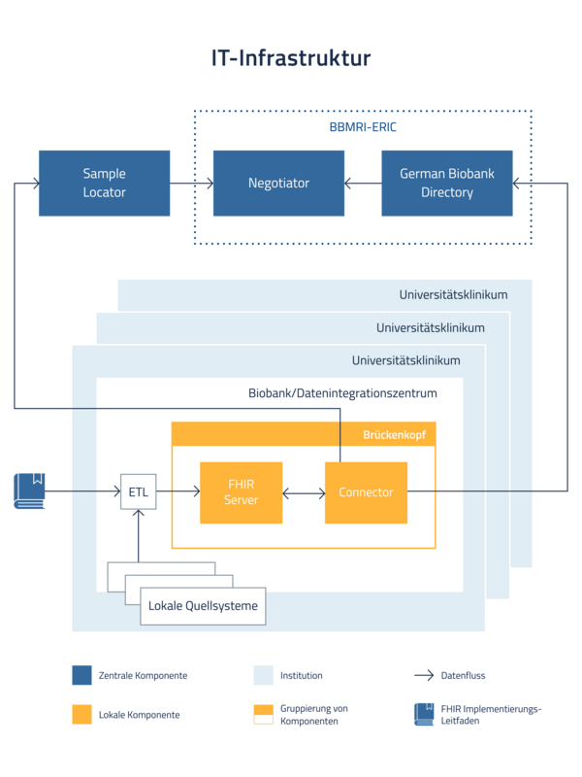
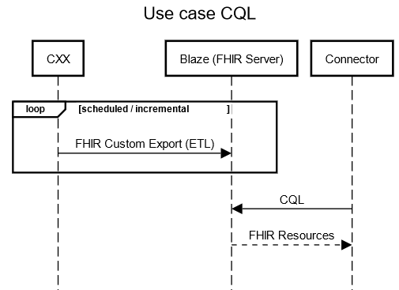
Architecture for federated searches
Quelle: https://www.bbmri.de/biobanking/it/infrastruktur/
Blaze: https://github.com/samply/blaze

Slide 20

DEMO

Slide 21
What is your Groovy experience?
Level 2: Worked with Java before
Level 1: Any programming skills
Level 3: Worked with Groovy before
Level 5: Worked with HAPI FHIR before
Level 6: Designed a Groovy DSL before
Level 0: No programming skills
Level 7: Call me for the dev team!

Slide 22



FHIR Custom Export: Overview
Extract from CXX data model
Scheduled (all patient records)
Incremental (single patient records on change)
FHIR bulk export requests
Transformation KAIROS FHIR DSL
Groovy + HAPI based
Multiple export projects supported
Additional data sources possible
Load to target
To file system
To REST endpoint
Kairos FHIR DSL scripts
CXX data

Slide 23
FHIR Custom Export: Setup
Server access is required!
Getting started: https://github.com/kairos-fhir/kairos-fhir-dsl-mapping-example/blob/master/gettingstarted.md
Demo

Slide 24
FHIR Custom Export: Scripting
Scripts in Groovy
Easy to learn, huge community
Recommended IDE: IntelliJ IDEA Community Edition: https://www.jetbrains.com/idea/
Easy version control possible (instead of ETL-Tools with graphical editor)
Collaboration between multiple CentraXX sites possible.
Scripts during runtime of CentraXX changeable.
Kairos-FHIR-DSL
published as Maven dependency on github packages: https://github.com/kairos-fhir/kairos-fhir-dsl-mapping-example/packages
Syntax correction / Code completion
Insights to CXX data model

Slide 25
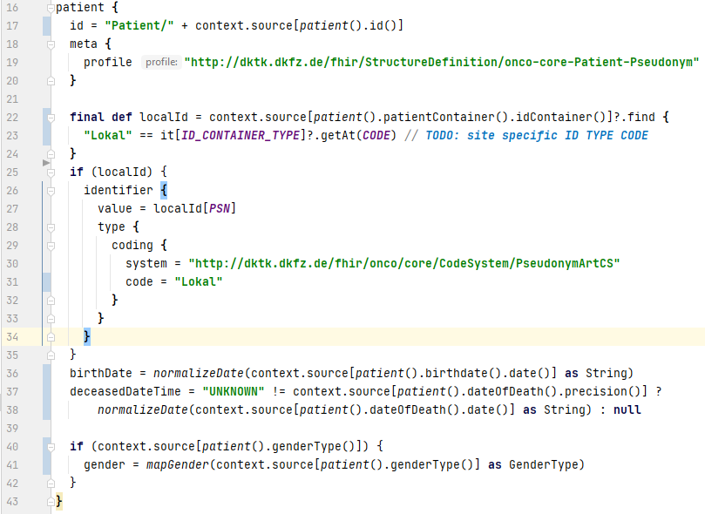
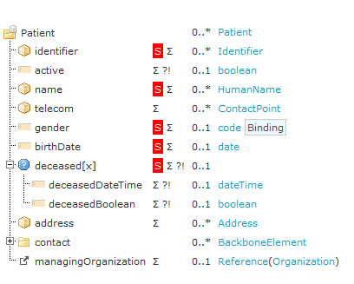
From FHIR profile to Groovy mapping
Spezifikation: https://simplifier.net/oncology/patientenpseudonym

Slide 26
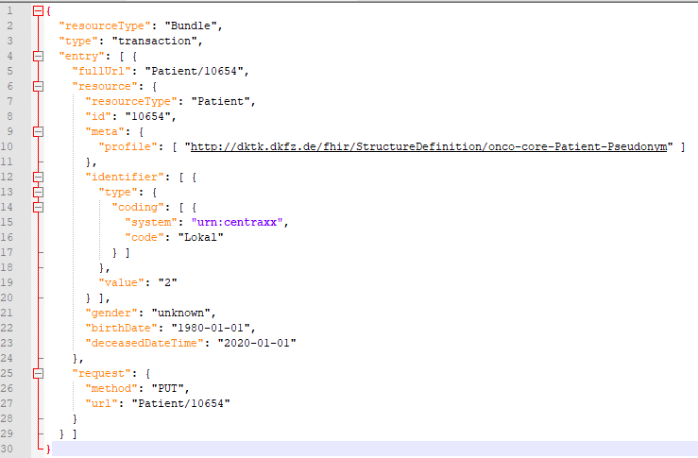
From Groovy mapping to FHIR message

Slide 27
Context Source Navigation
Context.source[]
Contains all CXX data for the selected CXX entity
Data type is Map<String, Object>
Map Key: CXX data point name, Map value: data point value
Value: simple type String representation or sub map for complex types
Example:
{ "firstname": "Max", "lirstname": "Mustermann", "birthdate": { "date": "2023-06-13", "precision": "DAY" } }
=> The map path “birthdate.date” is the address of the data point for value “2023-06-13”

Slide 28
Context Source Navigation
Context source is navigable by context paths
Context paths are the address to the data point value in the CXX data model
All path addresses are part of the DSL and grouped by its entity
All entities have a common entry class “RootEntities”
Examples:
patient().birthdate().date()
patient().patientContainer().idContainer().psn()

Slide 29
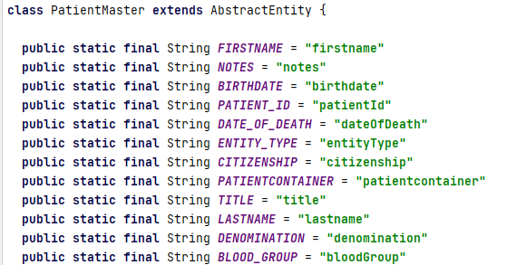
Context Source Navigation
Navigation paths can be combined with constants
Example:
final def globalId = context.source[patientMasterDataAnonymous().patientContainer().idContainer()]?.find { "DKTK" == it[ID_CONTAINER_TYPE]?.getAt(CODE) }.getAt[PSN]

Slide 30
FHIR Custom Export: DSL
Fork the example project on github
Extend or change existing scripts or write new scripts
Pull requests are welcome!
Demo

Slide 31
FHIR Custom Import: Overview
Loads project specific FHIR profiles
Project specific REST Endpoint
Multiple projects supported
Consumes FHIR bundles
Transform by KAIROS FHIR DSL
Groovy + HAPI based
Transformation to CXX FHIR Structures
Additional data sources possible
Load to CXX FHIR API
FHIR Bundle import (See CXX FHIR API)
Kairos FHIR DSL scripts
Source FHIR Bundles
CXX FHIR API
CXX database

Slide 32
FHIR Custom Import: DSL
Fork the example project on github: https://github.com/kairos-fhir/kairos-fhir-dsl-mapping-example/tree/master/src/main/groovy/customimport
Extend or change existing scripts or write new scripts
Pull requests are welcome!
Demo

